Slide 1
Grammar
A grammar G can be formally written as a 4-tuple (V, T, S, P) where −
V or VN is a set of variables or non-terminal symbols.
T or ∑ is a set of Terminal symbols.
S is a special variable called the Start symbol, S ∈ V
P is Production rules for Terminals and Non-terminals.
A production rule has the form α → β, where α and β are strings on V ∪ ∑ and least one symbol of α belongs to VN.

Slide 2
Grammar G1:
G1: ({S, A, B}, {a, b}, S, {S → AB, A → a, B → b})
Here,
S, A, and B are Non-terminal symbols;
a and b are Terminal symbols
S is the Start symbol, S ∈ N
Productions, P : S → AB, A → a, B → b

Slide 3
Grammar G2 −
G2= (({S, A}, {a, b}, S,{S → aAb, aA → aaAb, A → ε } )
Here,
S and A are Non-terminal symbols.
a and b are Terminal symbols.
ε is an empty string.
S is the Start symbol, S ∈ N
Production P : S → aAb, aA → aaAb, A → ε

Slide 4
Chomsky Hierarchy of Grammar and Formal Languages

Slide 5
Chomsky Hierarchy
Grammar Type | Grammar Accepted | Language Accepted | Automaton
Type 0 | Unrestricted grammar | Recursively enumerable language | Turing Machine
Type 1 | Context-sensitive grammar | Context-sensitive language | Linear-bounded automaton
Type 2 | Context-free grammar | Context-free language | Pushdown automaton
Type 3 | Regular grammar | Regular language | Finite state automaton

Slide 6
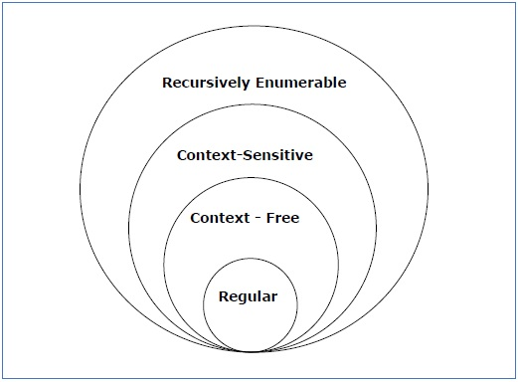
Relationship among the grammars

Slide 7
Type - 0 Grammar
Unrestricted or Phrase Structured Grammar
Generates Recursively Enumerable Languages
Productions are of the form α → β where α is a string of terminals and non-terminals with at least one non-terminal and α cannot be null. β is a string of terminals and non-terminals.
for e.g. A -> ABaC
bB -> aBc
CB -> ABD

Slide 8
Type - 1 Grammar
Generates context-sensitive languages.
Also called non contracting grammar. The rule S → ε is allowed if S does not appear on the right side of any rule.
Productions are of the form α A β → α B β, here A is Non-terminal. Whereas, α, β and B are strings of terminals and Non-terminals. α and β may be empty but B must be non empty.
For e.g. AB -> AbBba
A -> bbA
B -> ab

Slide 9
Type - 2 Grammar
Generates context free languages.
Productions are of the form A → B. Here A is Non-terminal and B is a string of terminals and non-terminals.
Languages generated by these grammars can be recognized by pushdown automaton.
For e.g. A -> AbBba
B -> bbA | b

Slide 10
Type - 3 Grammar
Generates regular languages.
Productions are of the form V → T*V | T*. Here V is Non-terminal, T is a terminal and * denotes zero or more symbols.
Languages generated by these grammars can be recognized by finite state automaton.
For e.g. A -> Bbba
B -> bb | b

